Slide 1
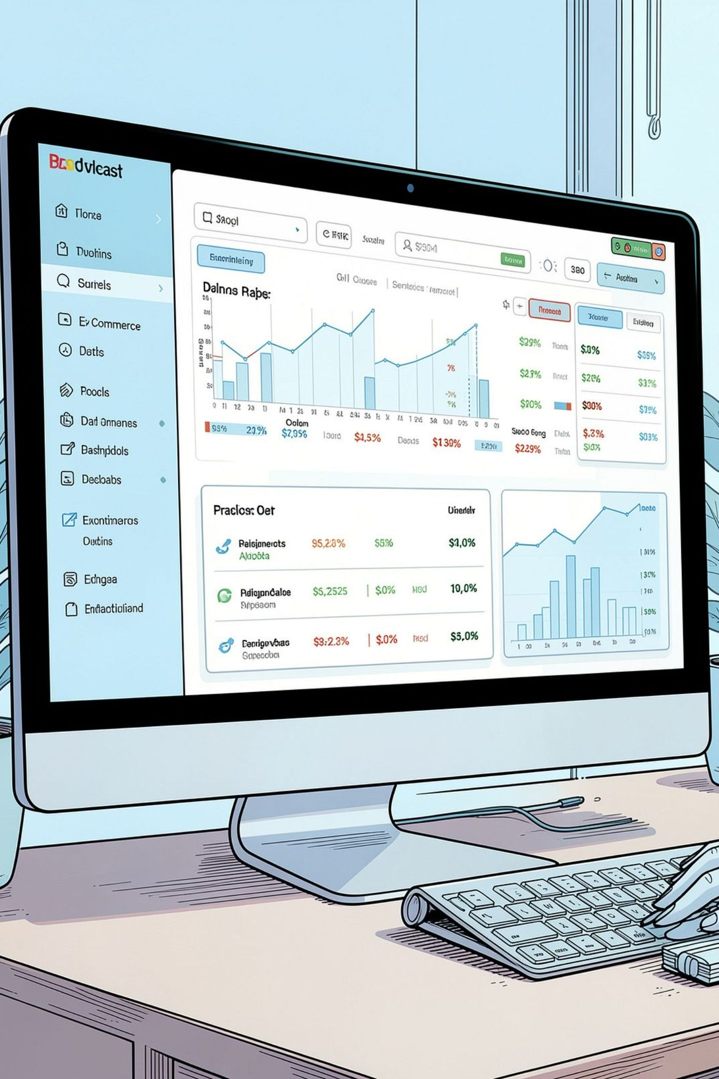
E‑COMMERCE ONLINE SALES ANALYSIS
Condensed insights from a 1,000‑record transaction dataset to inform revenue timing, product mix, city performance, and order‑value behaviour for strategic decisions.

Slide 2
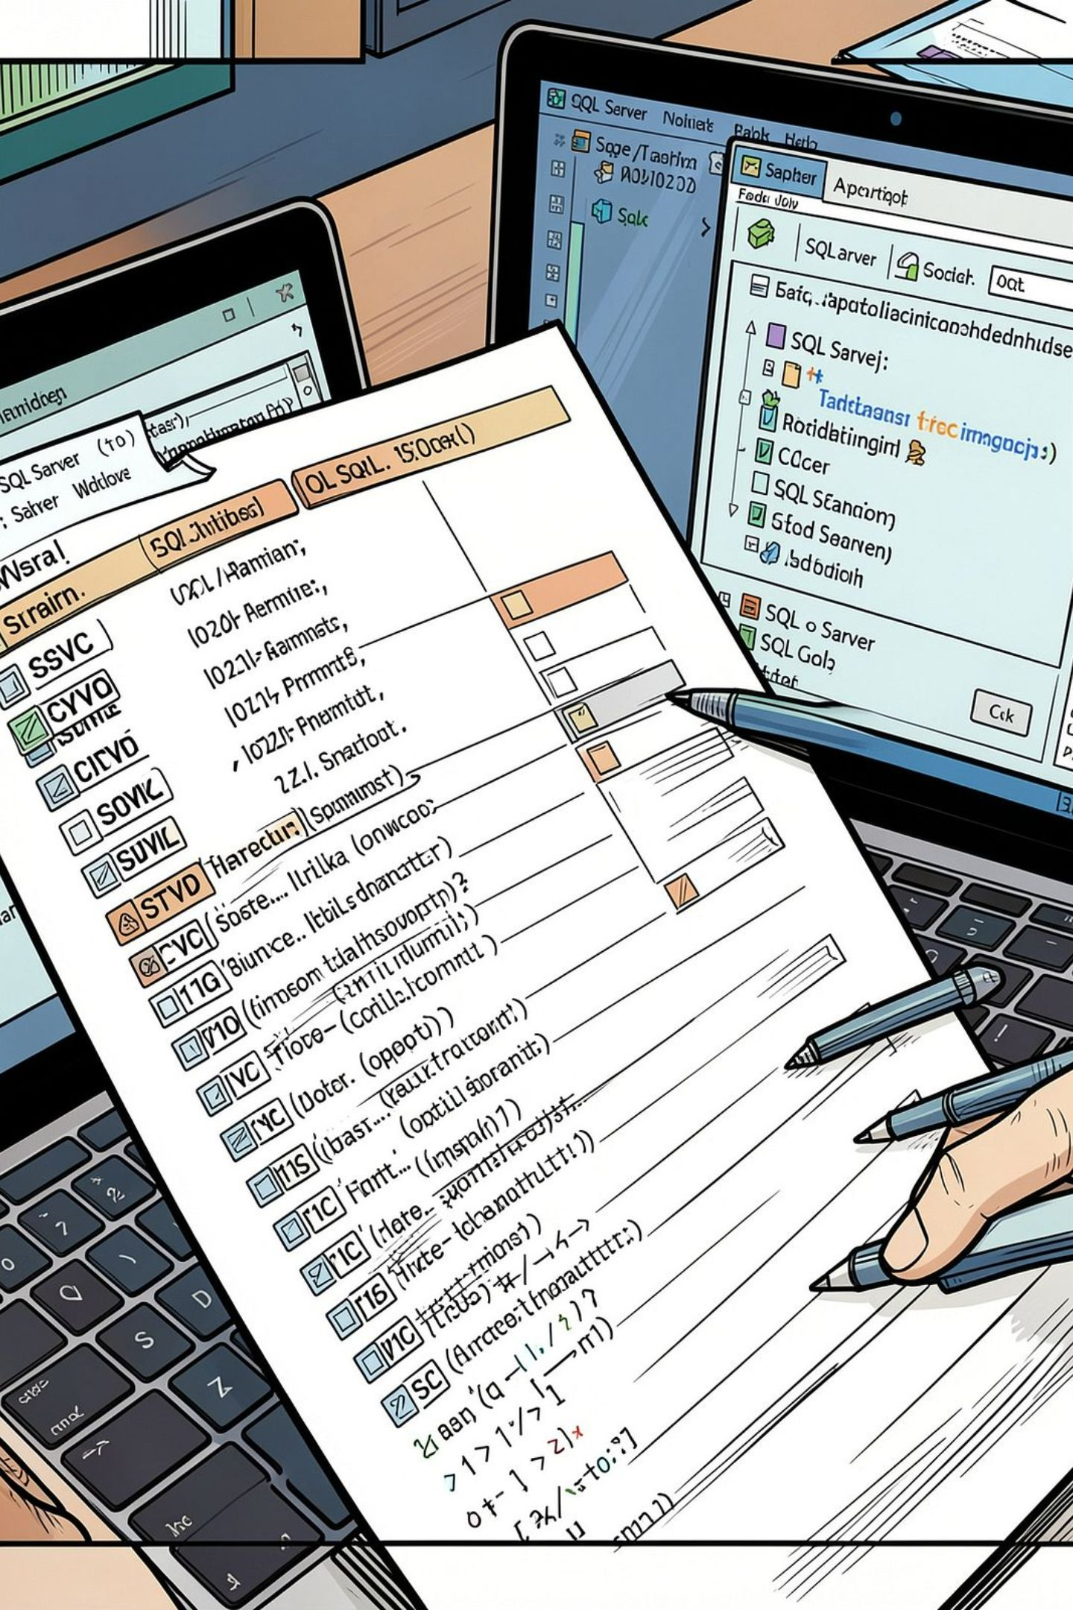
Dataset Summary
Sample
Key Fields
Objective
1,000 transaction records (CSV imported into Microsoft SQL Server).
Order_ID, Date, Product, Category, Quantity, Price, City.
Reveal revenue by time, product structure, top categories/cities, AOV and order behaviour.

Slide 3
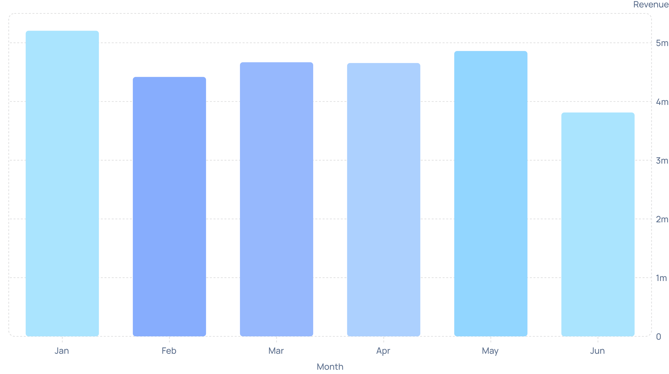
Revenue by Month (Jan–Jun 2026)

Slide 4
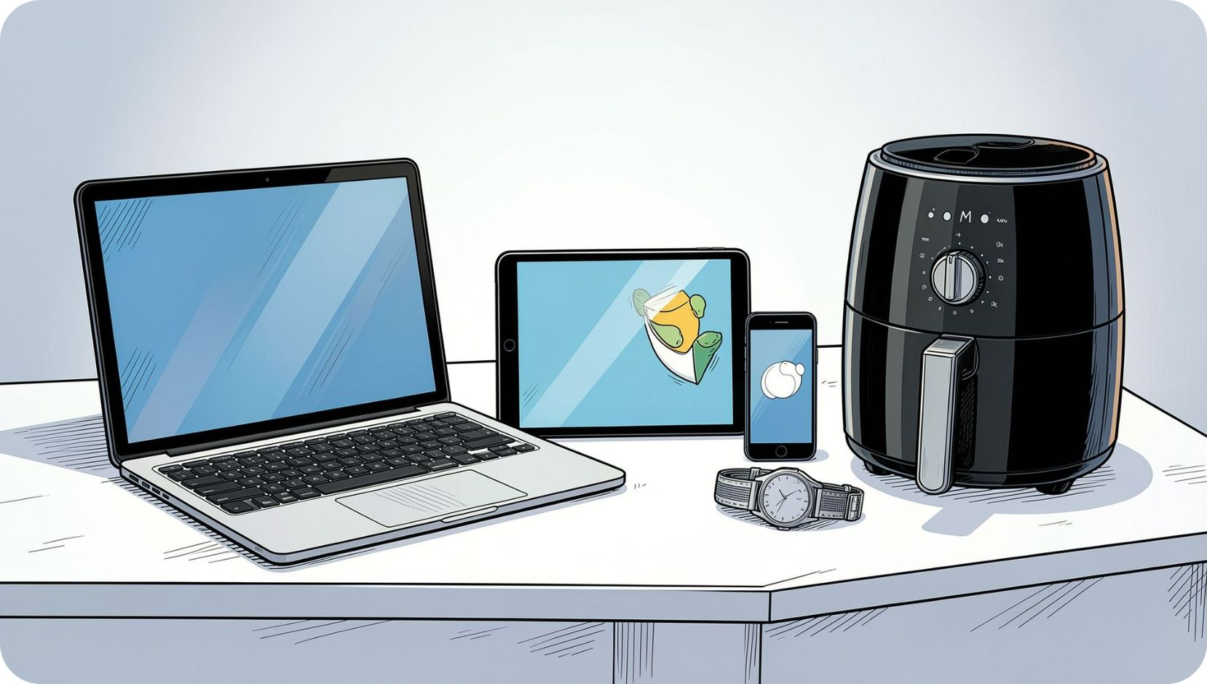
Top Products & Categories (Revenue)
Top 5 Products (Revenue)
Laptop: 11,411,335.17 · Tablet: 5,933,914.06 · Smartphone: 3,535,262.79 · Air Fryer: 1,533,421.53 · Watch: 1,203,724.82
Top 5 Categories (Revenue)
Electronics: 21,606,517.68 · Home Appliances: 3,141,481.72 · Accessories: 1,630,446.49 · Fashion: 1,152,368.38 · Books: 89,836.77
Electronics
Home Appliances
Primary revenue driver
Strong secondary contributor

Slide 5
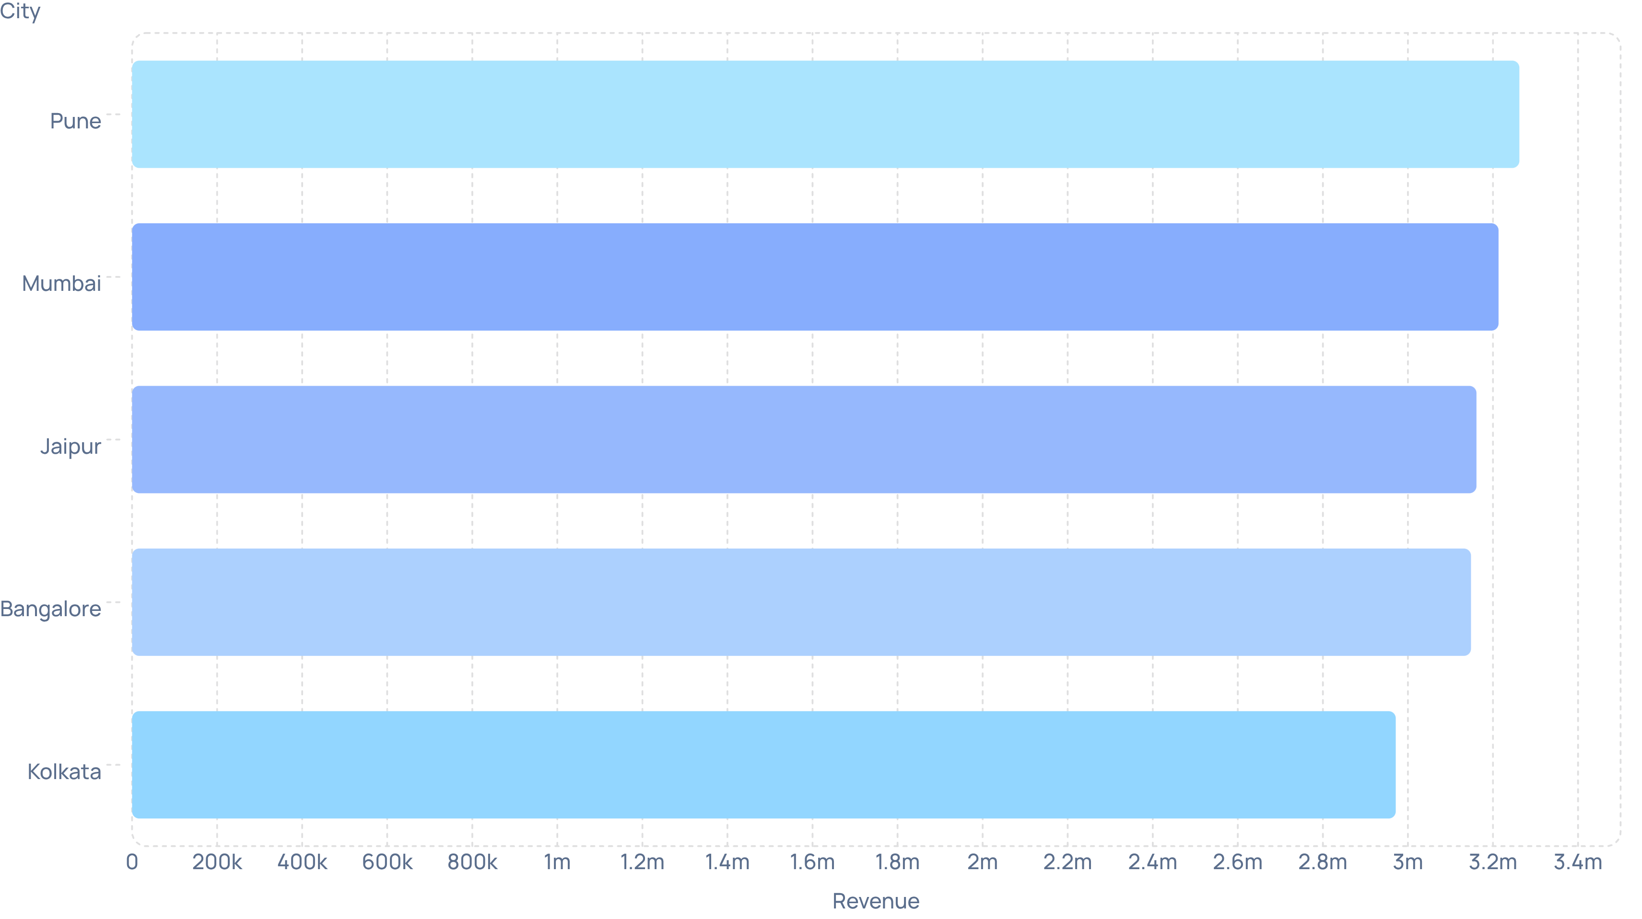
Top Cities by Revenue

Slide 6
Average Order Value (AOV) by City
Bangalore
Kolkata
Pune
AOV £35,776.05
AOV £34,153.33
AOV £31,981.15
Jaipur
Delhi
AOV £30,105.63
AOV £28,301.45

Slide 7
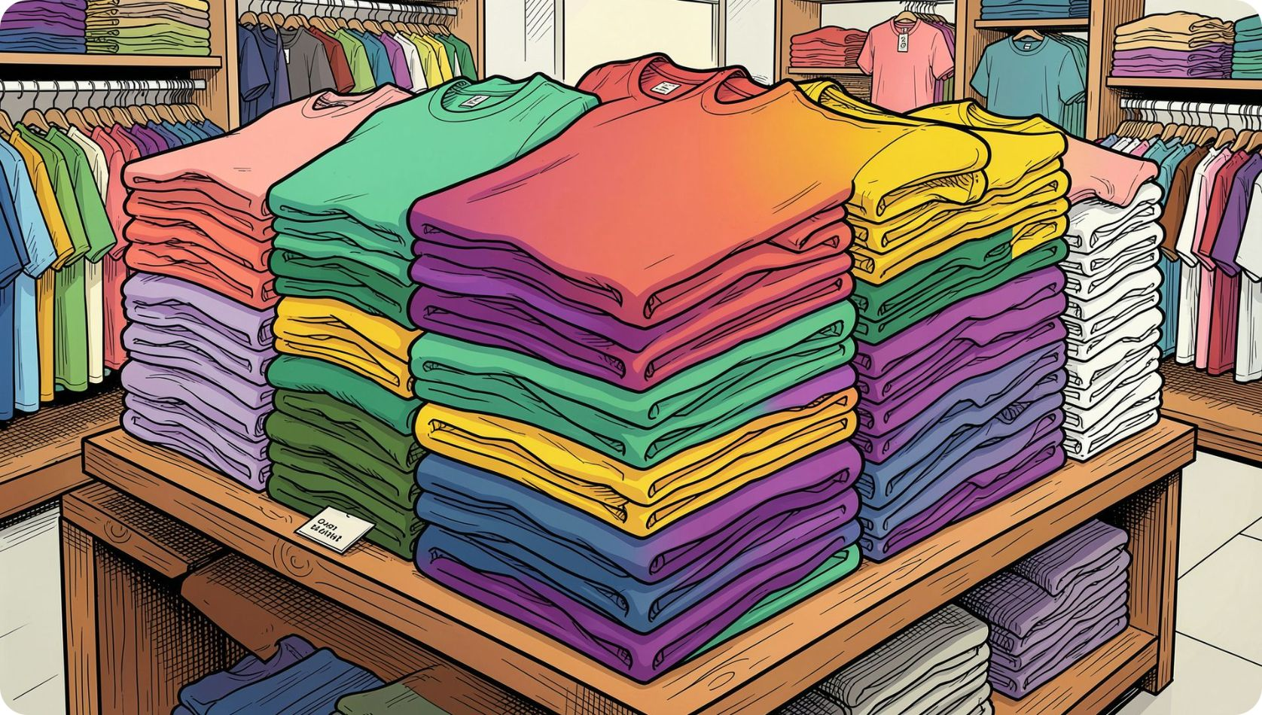

Quantity vs Revenue Leaders
Top by Quantity
Top by Revenue
T‑Shirt — 259 units (best‑selling by volume)
Laptop — 11,411,335.17 (highest revenue contributor)
Volume leaders differ from revenue leaders — opportunity for cross‑sell combos to convert high volume buyers to higher value items.

Slide 8

Revenue by Day of Week
Mid: Monday–Sunday
High: Tuesday
Low: Saturday

Slide 9


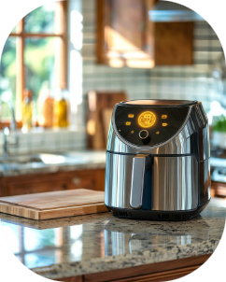
Top 3 Products per Category
Accessories
Electronics
Home Appliances
1 Watch — 1,203,724.82
2 Backpack — 426,721.67
1 Laptop — 11,411,335.17
2 Tablet — 5,933,914.06
3 Smartphone — 3,535,262.79
1 Air Fryer — 1,533,421.53
2 Coffee Maker — 812,719.87 · 3 Mixer — 795,340.32

Slide 10

Recommendations
Focus Inventory
Bundle & Cross‑sell
Timing Promotions
City‑Segmented Marketing
Prioritise stock & warranty optimisation for Laptops and Tablets — primary revenue drivers.
Use high‑volume items (T‑Shirts, accessories) in combos to upsell higher‑value products.
Concentrate marketing + flash sales on Monday–Tuesday when revenue is strongest.
Push premium offerings in Bangalore & Kolkata (high AOV); use discounts/combos in Hyderabad & Ahmedabad (low AOV).

